Slide 1
NLP Application
- A12 -
Intelligent Email Management System
22CNTThuc

Slide 2


TEAM MEMBERS
Nguyen Tran Trung Kien
21127327
Ho Bach Nhu Quynh
21127412
Nguyen Minh Thuan
21127448
Huynh Le Hai Duong
22127081

Slide 3
TABLE OF CONTENTS
01.
02.
03.
MOTIVATION
TARGETS
FEATURES
05.
06.
07.
system architecture
assessment
PROSPECTS
04.
User interface
Why we need this?
Our goals
What can we do?
How it looks like?
Core diagrams and more
Our approach in model evaluation
Advancements in the future

Slide 4
01.
MOTIVATION
Why we need this?

Slide 5
MOTIVATION
- Overwhelming email volume.
- Time & Resource efficiency.
- Critical information extraction.
- Enhanced productivity.
- AI-driven insights.
Notes:
- Enhanced productivity: grasp the essence of emails at a glance, enabling faster decision-making.
- Seamless workflow: Intelligent categorization integrates with existing email systems, reducing manual overhead and ensuring consistent organization.
- AI-driven Insights: Leveraging advanced NLP (including LLMs and embeddings) offers deeper analysis, improving both accuracy and adaptability over time.

Slide 6
02.
TARGETS
Our goals

Slide 7
TARGETS
Basic email clients with critical features, plus:
- Automate email management.
- Enhance email understanding.
- Improve classification accuracy.
- Prioritize critical communication.
- Suggest responds adequately based on email context.

Slide 8
03.
FEATURES
What can we do?

Slide 9
Features
Apart from basic features of every email client, our application includes:
- Email classification.
- Email prioritization.
- Abstractive summarization.
- AI-based reply suggestion.
Notes:
Ngoài những tính năng cơ bản (đăng nhập, xem mail, trả lời)…
Ứng dụng của nhóm em còn có một số tính năng sử dụng AI như:
Phân loại email
Xếp hạng độ quan trọng của email
Tóm tắt nội dung email
Gợi ý trả lời

Slide 10
KEY Feature 1
- Email classification:
+ Pre-defined labels: Work, Commercial, Fraud, Others.
+ Classification activated on unlabeled emails received.
Notes:
Được kích hoạt ngay khi người dùng đăng nhập
Phân loại theo các category cho trước, gồm...
Chạy khi có mail chưa được gán nhãn (mail mới) và người dùng nhấn load page

Slide 11
KEY Feature 2
- Email prioritization:
+ Based on scores: Subjects, Timestamp, Keywords and so on.
+ Read/responded emails will be marked as less crucial.
Notes:
Được kích hoạt ngay khi người dùng đăng nhập
Độ quan trọng được đánh giá bằng thang điểm có min là 0
Điểm được chấm dựa trên tiêu đề, thời điểm nhận mail, keyword trong nội dung
Email đã được đọc/trả lời sẽ giảm độ quan trọng

Slide 12
KEY Feature 3
- Abstractive summarization:
+ Using AI model: Gemini.
+ Summarized content displayed in juxtaposition with the original content.
Notes:
Được kích hoạt ngay khi nhấn xem nội dung mail

Slide 13
KEY Feature 4
- AI-based reply suggestion:
+ Activated with a button.
+ Integrated with reply workflow.
Notes:
Được kích hoạt ngay khi người dùng nhấn nút

Slide 14
USE CASE DIAGRAM
Notes:
User sẽ có các use case như
System sẽ thực hiện các feature như...
Ngoài ra, Gmail API sẽ dùng thông tin user nhập vào để lấy gmail data từ chính tài khoản của người dùng

Slide 15
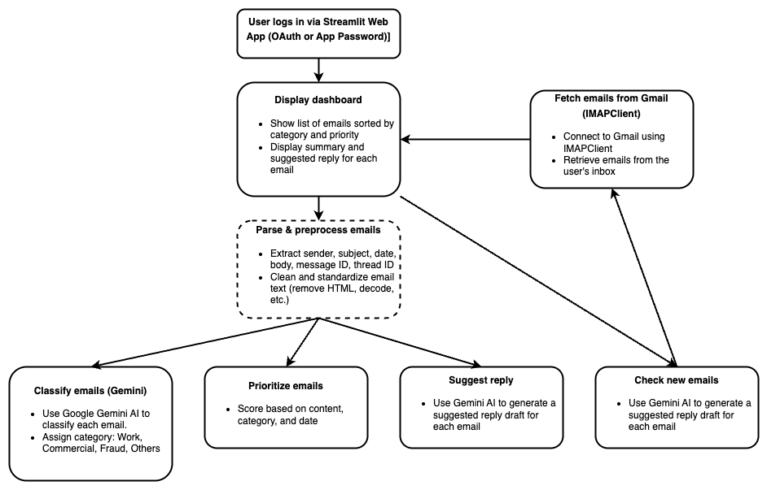
USeR FLOW

Slide 16
04.
User interface
How it looks like?

Slide 17
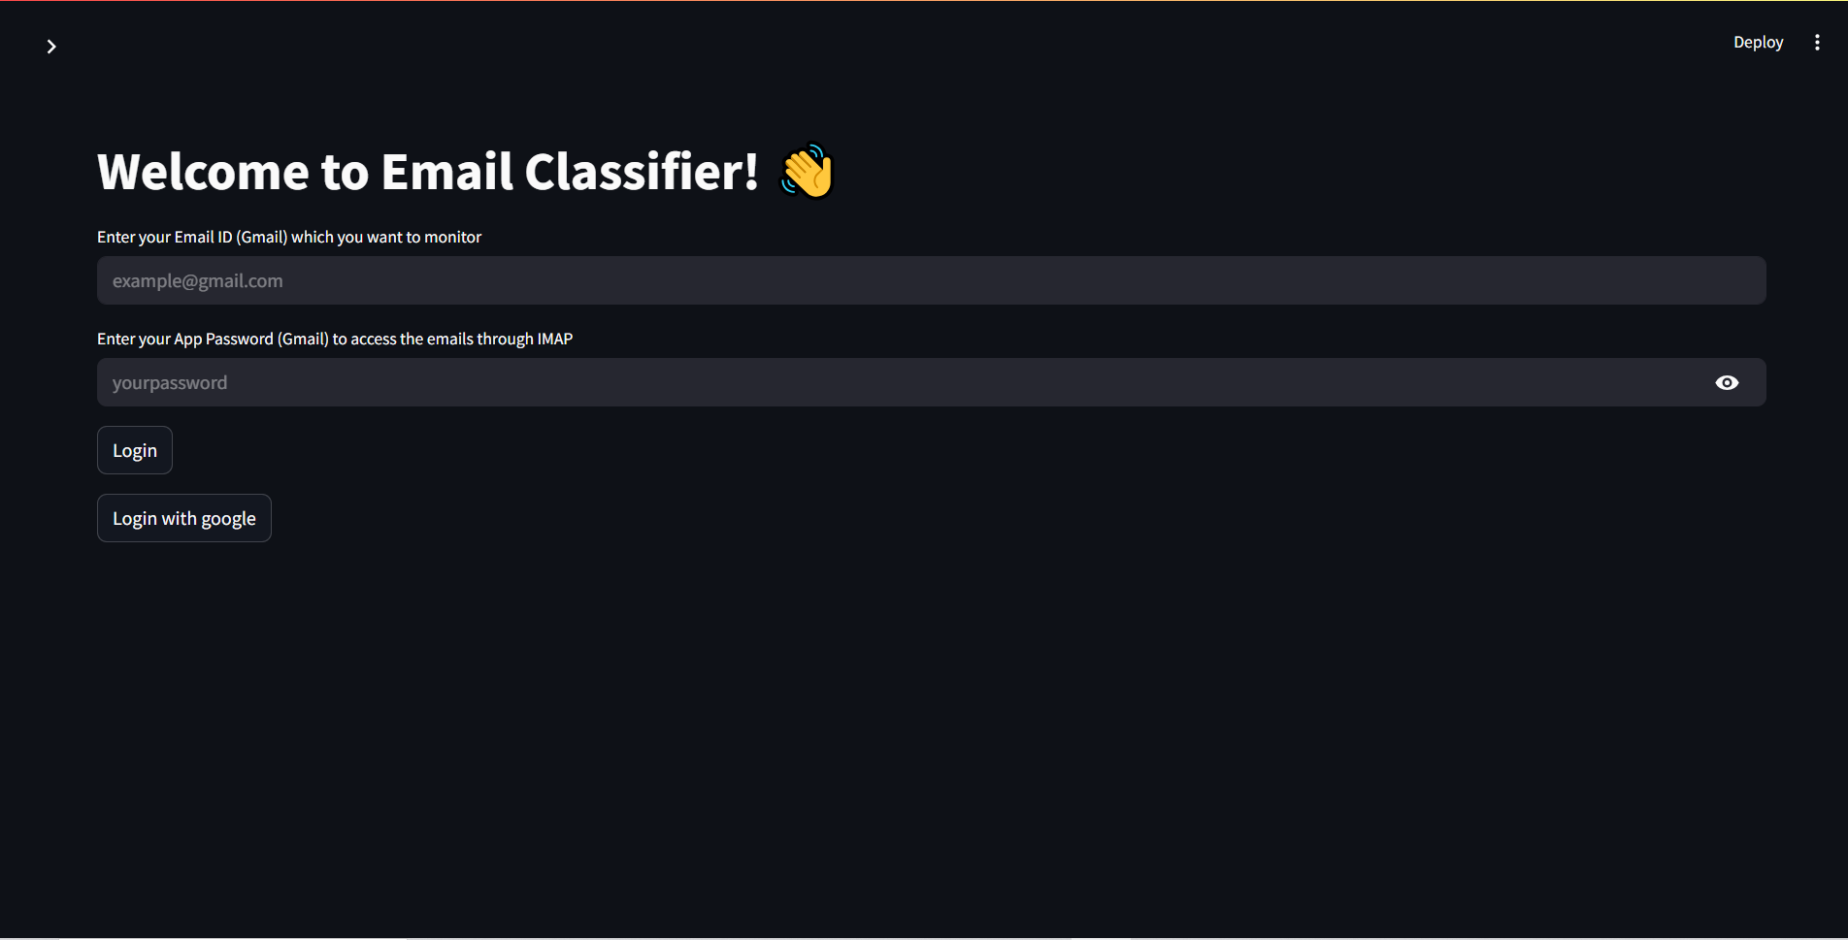
LOgin page
Notes:
Được kích hoạt ngay khi người dùng nhấn nút

Slide 18
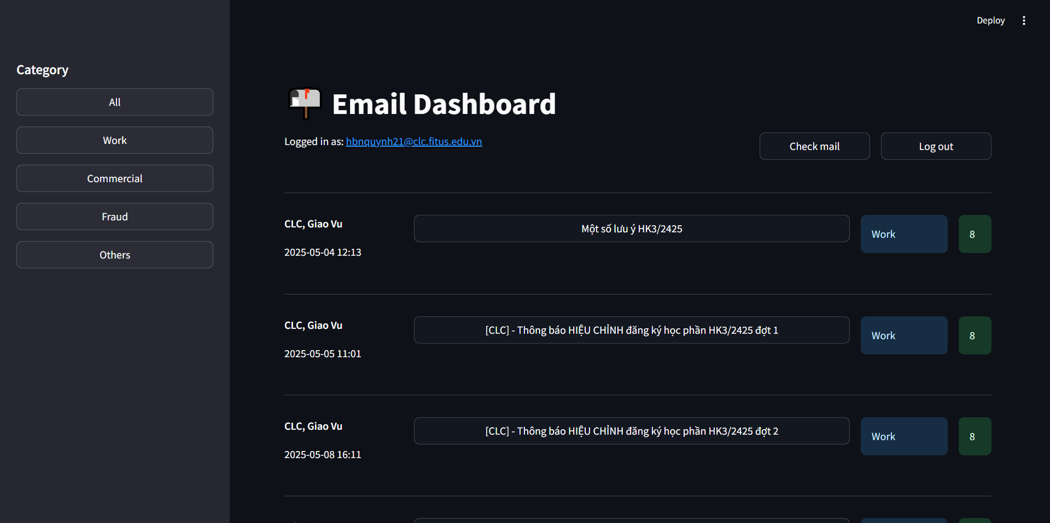
dashboard
Notes:
Được kích hoạt ngay khi người dùng nhấn nút

Slide 19
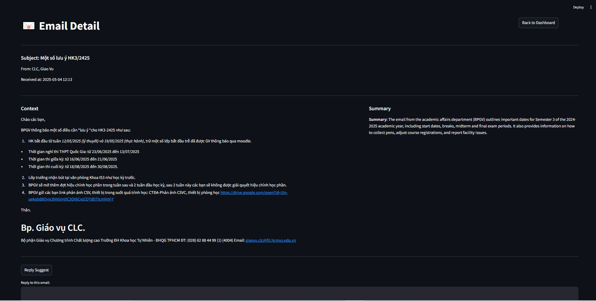
Mail detail
Notes:
Được kích hoạt ngay khi người dùng nhấn nút

Slide 20
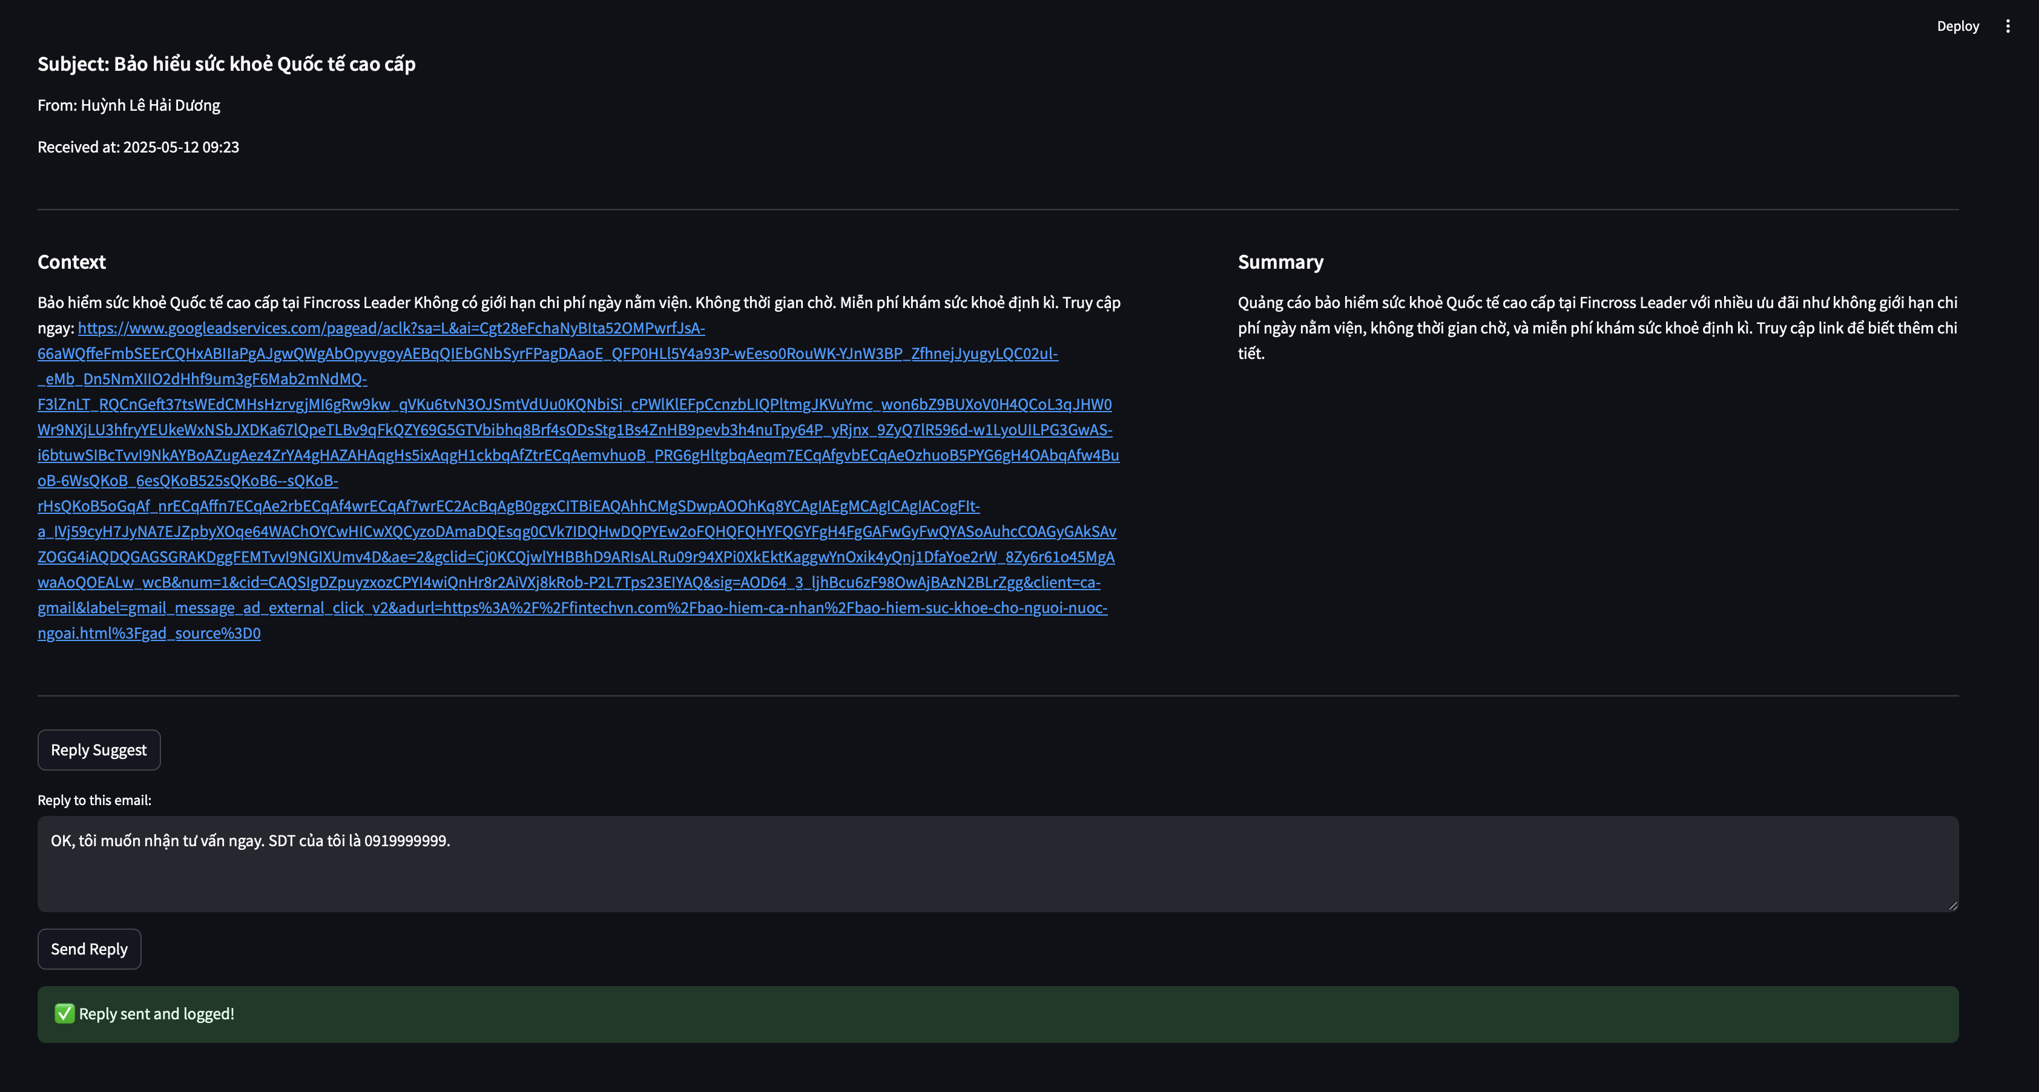
Mail detail
Notes:
Được kích hoạt ngay khi người dùng nhấn nút

Slide 21
05.
system architecture
Core diagrams and more

Slide 22
OUR APPROACH
- Apply mail-automation for Gmail
- Using Gemini for 4 features through prompt engineering
+ Free and seamlessly access through API
- Using AI generated email for evaluation

Slide 23
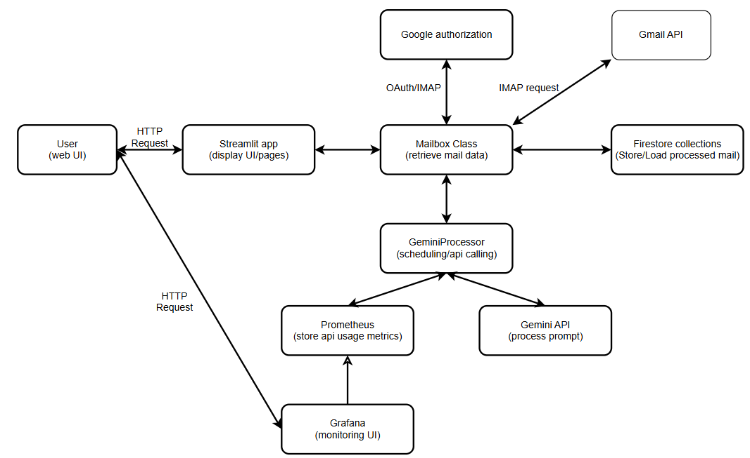
system architect

Slide 24
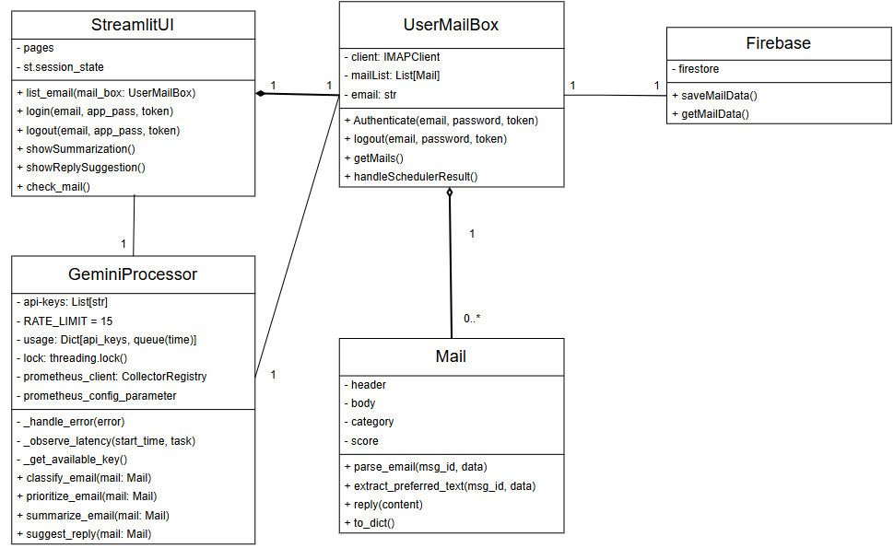
UML system design

Slide 25
DATA description
AI generated dataset.
INPUT: Email
- Subject, sender, recipient, timestamp, and full email body.
OUTPUT: category, priority score, summarized content.

Slide 26

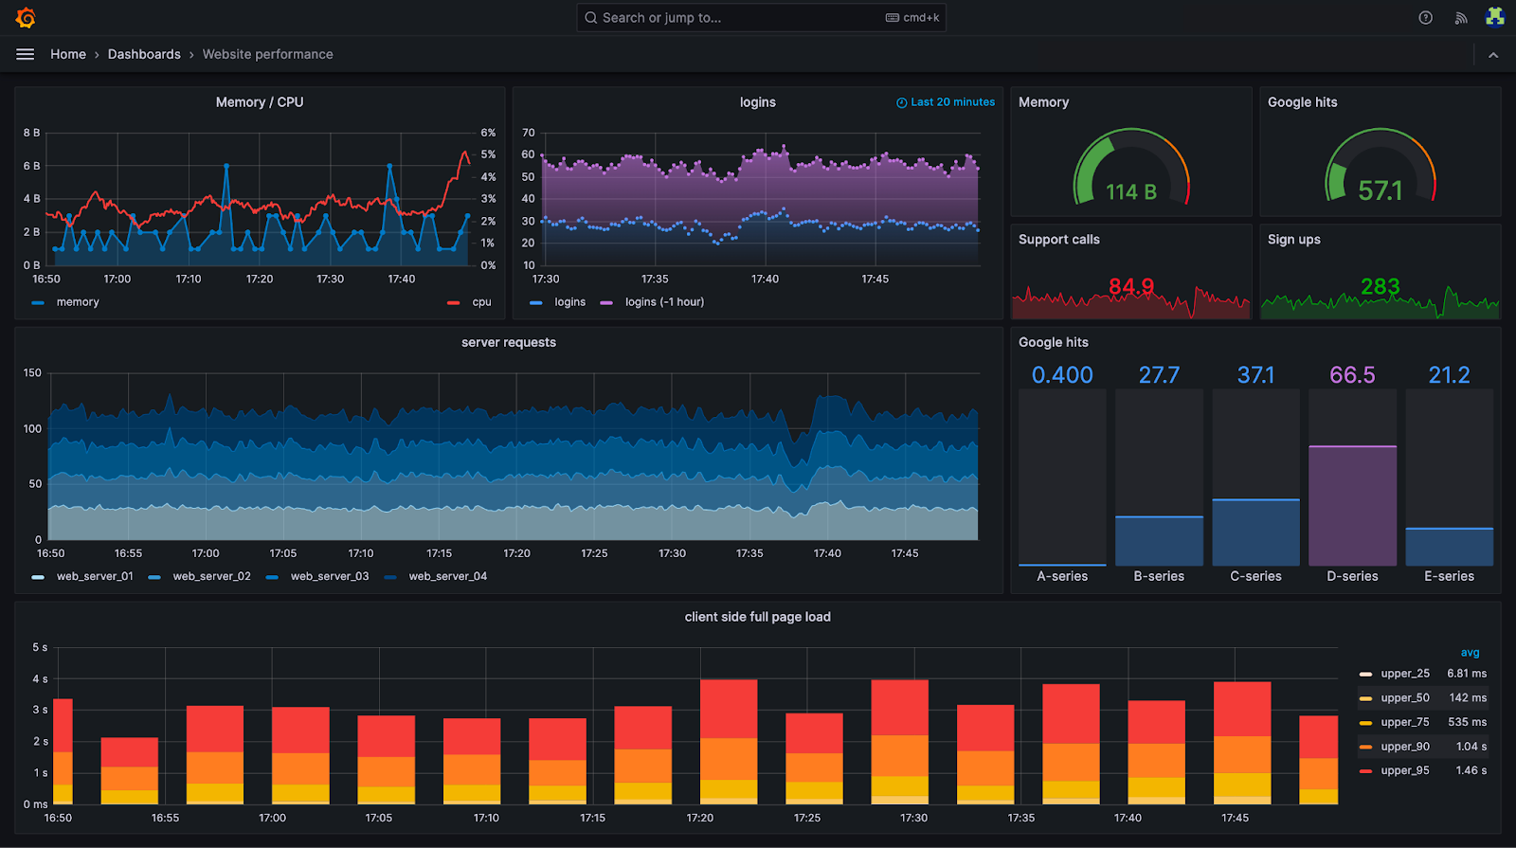

model monitoring
Ensure accuracy and output quality
Detect errors and anomalies (delays, crashes, API errors)
Maintain stable real-time performance
Early warnings for timely handling

Slide 27
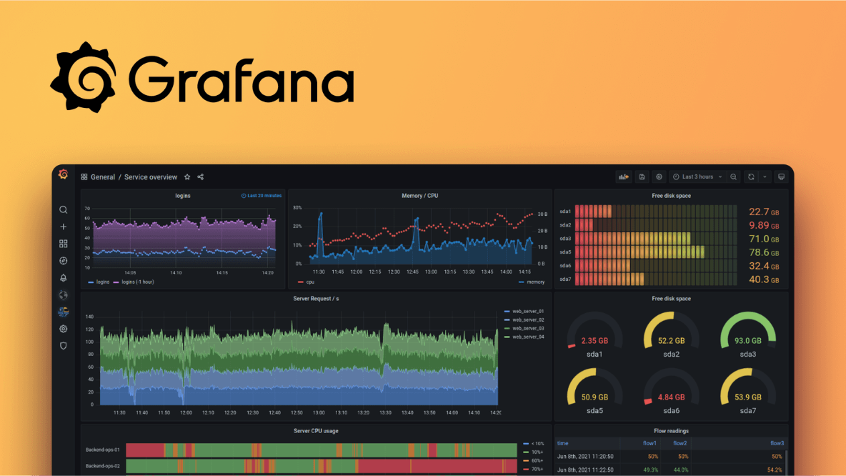
model monitoring
Real-time Monitoring
Easy customization and expansion
Integrates well with Prometheus

Slide 28
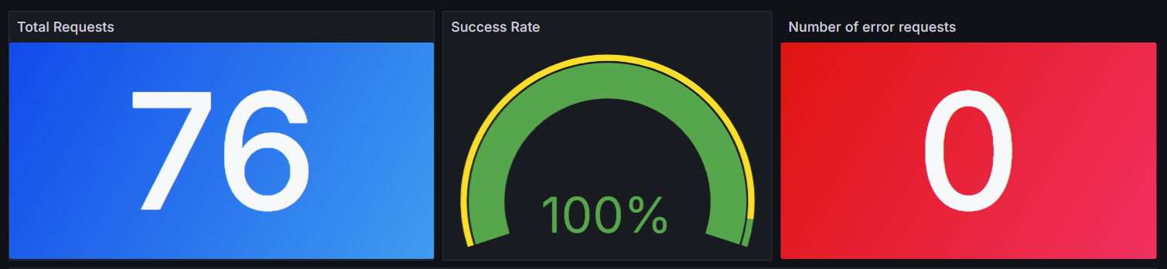
GRAFANA DASHBOARD
Total number of requests made
Success rate of requests
Number of failed requests

Slide 29
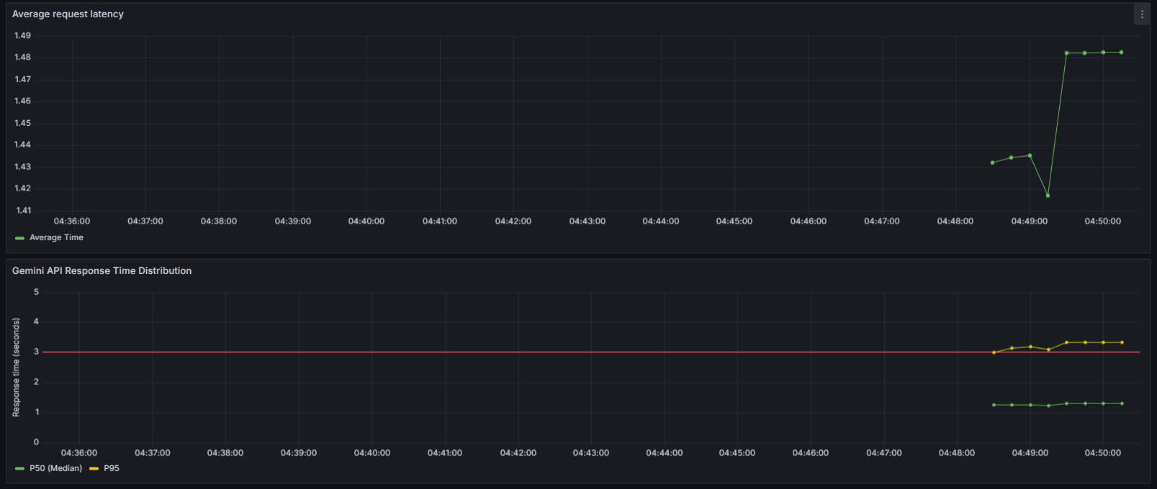
GRAFANA DASHBOARD
Average request latency
Response Time Distribution

Slide 30
06.
assessment
Our approach in model evaluation

Slide 31
Model Evaluation
Model evaluation goals:
Ensure the model works well
Verify the model's ability to respond to real-world data
Provide comparison metrics to improve, adjust, or change the model
Notes:
Real-Time Monitoring:
Dashboard tracks classification accuracy, response times, and load metrics
Visualizes key performance indicators (KPIs) such as model latency, error rates, and throughput
Performance Analysis:
Aggregates logs and metrics from each processing stage for in-depth performance insights
Detects anomalies and model drift through predefined thresholds and alerting systems
Iterative Improvements:
Enables direct feedback loops for optimizing model tuning and deployment strategies
Supports correlation analysis between email volume, system load, and model behavior

Slide 32
Model Evaluation
Evaluation criteria for the Classification feature
Accuracy: Correct classification rate of the model
Recall for each category
Consistency: Stability of results after multiple runs with the same input
Latency: Real-time response & user experience
Notes:
Real-Time Monitoring:
Dashboard tracks classification accuracy, response times, and load metrics
Visualizes key performance indicators (KPIs) such as model latency, error rates, and throughput
Performance Analysis:
Aggregates logs and metrics from each processing stage for in-depth performance insights
Detects anomalies and model drift through predefined thresholds and alerting systems
Iterative Improvements:
Enables direct feedback loops for optimizing model tuning and deployment strategies
Supports correlation analysis between email volume, system load, and model behavior

Slide 33
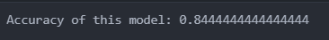
Accuracy: Correct classification rate of the model
As we can see, the model accuracy is 84% on the dataset
From the model accuracy, we can see that the model has a relatively good classification ability
Notes:
Real-Time Monitoring:
Dashboard tracks classification accuracy, response times, and load metrics
Visualizes key performance indicators (KPIs) such as model latency, error rates, and throughput
Performance Analysis:
Aggregates logs and metrics from each processing stage for in-depth performance insights
Detects anomalies and model drift through predefined thresholds and alerting systems
Iterative Improvements:
Enables direct feedback loops for optimizing model tuning and deployment strategies
Supports correlation analysis between email volume, system load, and model behavior

Slide 34
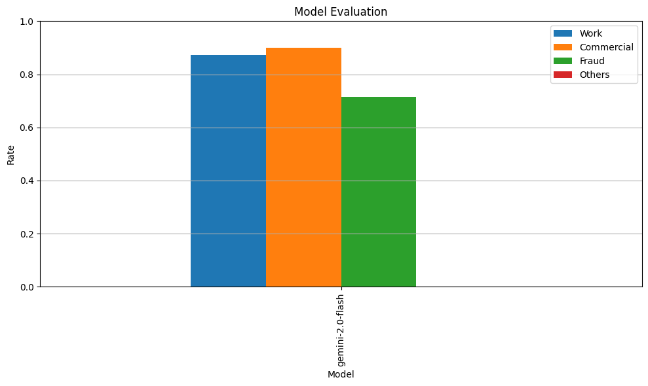
Recall for each category

Slide 35
The consistency of the classification task:
After 2 runs on the same dataset, we get the similarity ratio between the 2 results up to more than 97%
This shows that the results of the model's classification task ensure consistency

Slide 36
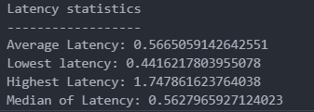
The latency of the classification task
The response time of the classification task is 0.56s on average, the slowest is 1.75s and the fastest is 0.44s.
This shows that the model has a fast response time, suitable for real-time applications.

Slide 37
07.
PROSPECTS
Advancements in the future

Slide 38
PROSPECTS
Current Limits:
- No support for Images/Files.
- Not all basic email clients implemented.
Future Improvements:
- Multimodal data processing.
- Enhanced Natural Language Processing.
- Implement missing features.
Notes:
Current Drawbacks:
No Support for Images/Files:
The system currently cannot extract or analyze information contained in attached images or files.
Not all basic email clients implemented: cc/bcc, scheduled emai.
Future Improvements:
Xử lý dữ liệu đa phương thức
Tích hợp OCR và phân tích tệp tin để xử lý hình ảnh, tài liệu được quét và các định dạng tệp đa dạng.
Mở rộng khả năng của hệ thống trong việc xử lý nội dung phong phú hơn ngoài văn bản thuần túy.
Xử lý ngôn ngữ tự nhiên nâng cao
Phát triển các thuật toán để xử lý email không có cấu trúc hoặc bán cấu trúc một cách hiệu quả hơn.
Mở rộng khả năng ứng dụng của hệ thống bằng cách hỗ trợ các định dạng email phức tạp và phong cách viết đa dạng.

Slide 39
-THE END-
Thanks for listening!

